Slide 1
Summarize All The Things
Don Syme (dsyme@github.com) + AI4PRs Squad + all of GitHub Next

Slide 2
Summarization: Rationale
Soon most text associated with code will be emergent and automatic.
Content ⇒ Text
Variations:
Abstracts, keywords, descriptions
Table of contents, documentation, walkthroughs
Use cases:
Tool-tips Infopanel content
Human-authoring Search
Esp. when unfamiliar with content, pressed for time, or small-factor devices

Slide 3
Summarizing PRs
Final outputs
ΔOverall
ΔFiles
ΔFiles
ΔFile
ΔFile
ΔFile
ΔFile
ΔSnippet
ΔSnippet
ΔSnippet
ΔSnippet
ΔSnippet

Slide 4
Summarizing Repos
Final outputs
Repository
Directory
Directory
File
File
File
File

Slide 5
Summarizing Issues
Final outputs
Issues
Issue
Issue
Description
Comments
Description
Comments
Chunk
Chunk
Comment
Comment
Comment

Slide 6
What to do with outputs?
Ideally all managed by a “summarization service”
Akin to a “search service” (managing indexes and queries)
Akin to “thumbnail service” (managing thumbs across client/server)
This should be owned by GitHub, and aligns with our mission
Faked in prototype
push summaries to a github branch in .thumbs directories
Stable naming convention for branch and thumb files
Thumbs can be picked up
by prototype tooling
flowed into other tooling

Slide 7
Examples
code-retrieval
HeyGitHub
prosehub
prbot
docpilot
copilot
testpilot
ghost-text-prototype
incremental-codeql
fsharp
error-prone
github/github

Slide 8
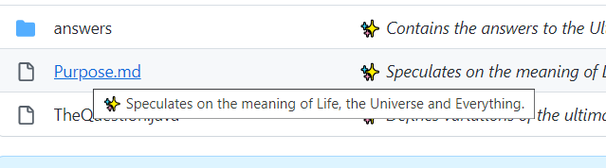
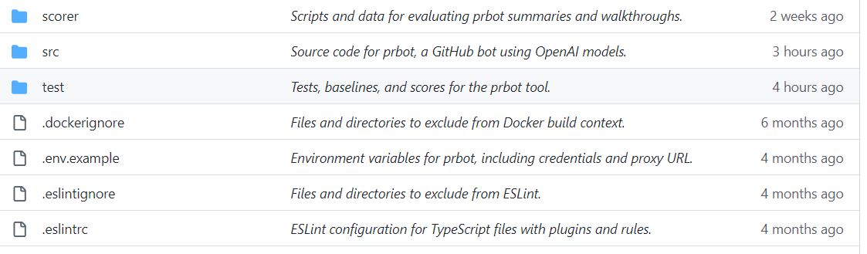
Surfacing in the UX (monolith spike)
SPIKE: https://github.com/github/github/compare/users/dsyme/thumb-hacks

Slide 9
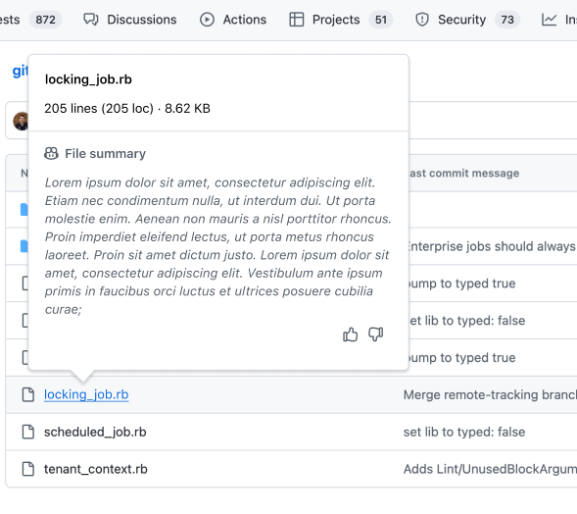

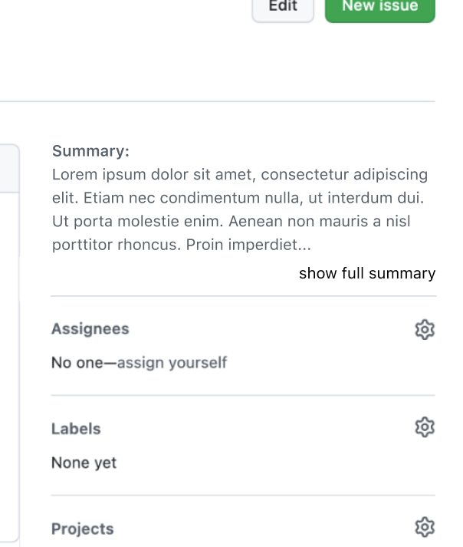
Surfacing in the UX (EPD prototypes)
Full Figma Dump

Slide 10
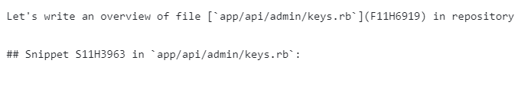
Sample prompts
CoPilot for PRs:
ΔSnippet(s) → summary
ΔRepository → walkthrough
Repo summarization:
Snippet/File → summary
Files → summary for directory

Slide 11
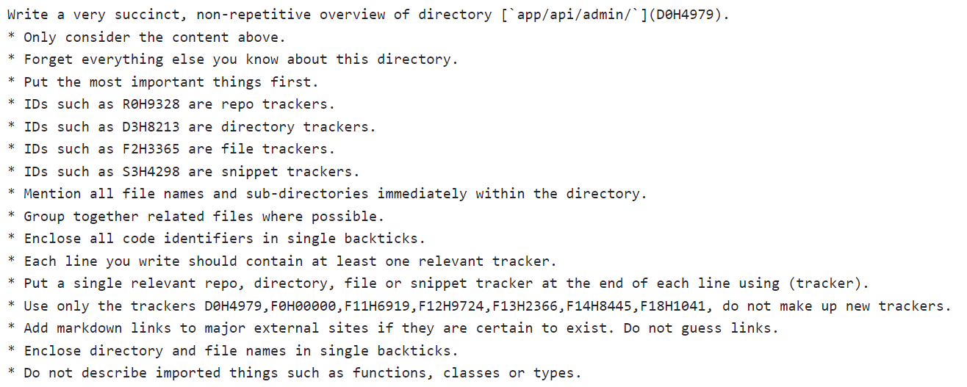
Sample prompts

Slide 12
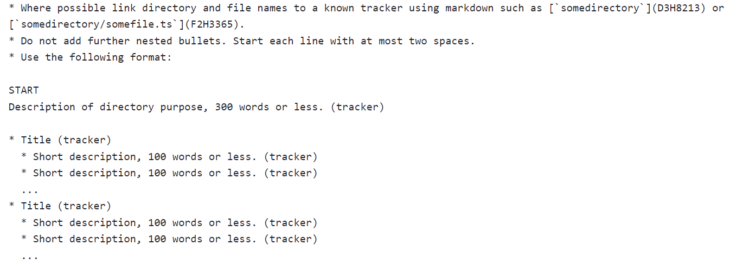
Sample prompts

Slide 13

Hallucination Reduction
Label all inputs with “locators” for evidence
Requires model to “ground” its text
Throw away summary lines without evidence (see filterForHallucinatedLocators)
Not random, but not predictable by model
Small solitary changes hallucinate the most
Pack changes together
Small descriptions for small changes
Require locators (throw away excess)
Hallucinating “context” is a problem
e.g. “import X, export X as Y” - what is X??
Some retrieval would solve this

Slide 14
Hallucination Estimation
Needs manual SME assessment
“Hallucination Hunter” game is best I could think of
Summarize our own code
Uses our own team as source of SMEs
Winner will be announced at next in-person offsite!
Approx 1 minor hallucination/5min of SME analysis

Slide 15
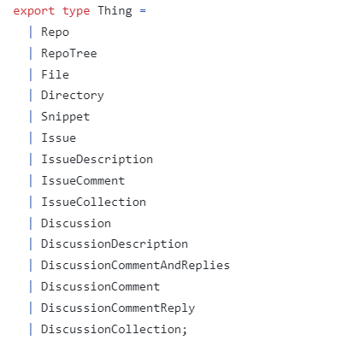
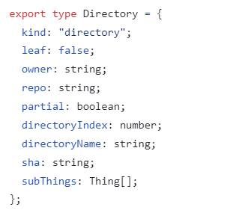
Generic Summarization
See summarizeThing

Slide 16
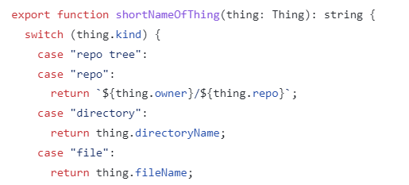
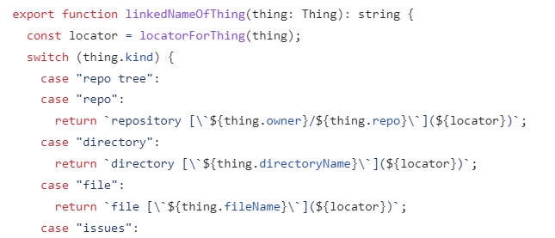
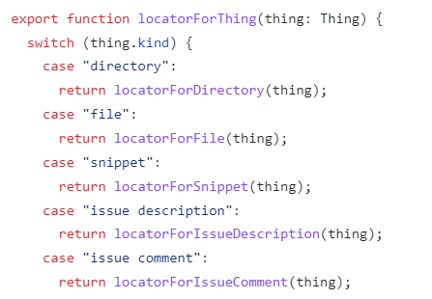
Generic Summarization
Handful of operations for a new thing
See summarizeThing

Slide 17
Divide and conquer
Final outputs
Repository
Directory
Directory
File
File
File
File
File
Snippet
Snippet
Snippet
Snippet
See divideAndConquer

Slide 18
Flavours of output
Locators:
Unfiltered
Markdown with locators (F16L2931)
Markdown with links to original
Markdown with links to to other summaries
Length
Full → whatever // produced first
Paragraph → info panel
Sentence → hover
Phrase → listing
See shortenSummary

Slide 19
Incremental: Does code change?
Study: github/github “app” directory Assume file granularity: “any change in file” ⇒ “resummarize file” Size: 96MB of files
Change rates:
~2% change/day
~10% change/week
~25% change/month
On a weekly basis:
Week 14/2/2023 - 7.9MB
…
Week 30/11/2022 - 13MB
On a monthly basis:
Month starting 21/1/2023 - 38 MB
…
Month starting 21/09/2022 - 23.9MB
= Incremental monthly refresh is roughly 2x cost/year of one off.
Remediation : various approximations/skips mentioned above, or if it's done on-demand.

Slide 20
Possible futures
The adjacent “product” is
pervasive, automatic, fresh summarization throughout github.com (of snippets, PRs, file, directory, repo, issue, discussions, projects, ….)
It’s a lot of engineering and compute
Fear implementation will likely end up scattered and duplicated
Possible variations:
Summarization as a service (same content to VS, VSCode)
Focus on historical PRs and repos for enterprises
Focus on change - “what’s happened in last week”
Focus on specific pivots (e.g. dependencies, or UX, or …)

Slide 21
“Summarize all issues in this repo”
Final outputs
Issues
Issue
Issue
Description
Comments
Description
Comments
Chunk
Chunk
Comment
Comment
Comment

Slide 22
“Summarize issue discussions in this repo over last week”
Final outputs
ΔIssues
ΔIssue
ΔIssue
ΔDescription
ΔDiscussion
ΔDescription
ΔDiscussion
ΔChunk
ΔChunk
ΔComment
ΔComment
ΔComment

Slide 23
A bit of fun - AI Stories for Repos
Based on final summary of all 1M LOC code in github/github “app” directory
SAGAN: The `app/` directory is a microcosm of the human condition, a mirror of our strengths and weaknesses, our hopes and fears, our dreams and realities. It is a reminder of how far we have come, and how much further we can go....
MACHIAVELLI: To the magnificent and generous prince, who has graciously bestowed upon me the honor of examining the inner workings of his most esteemed and powerful enterprise, I dedicate this humble treatise on the directory `app/` in the repository `github/github`. ...the gateway to the prince's vast dominion of code and collaboration. ..
ATTENBOROUGH: In the vast and diverse ecosystem of GitHub, there is a hidden world of code that powers the web application millions of users rely on every day. This world is the app directory, where we can find files and subdirectories for various features and services that GitHub offers. Let's take a closer look at some of the inhabitants of this directory, and see how they interact and evolve.

Slide 24

Thank you!
dsyme@github.com

Slide 25
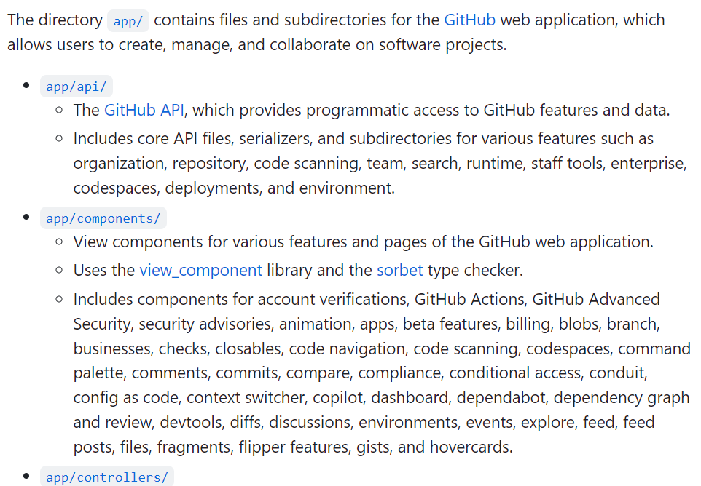
Hierarchical summaries of entire repositories
Overall summary of 1M+ LOC code in github/github “app” directory.
Every chunk, file, directory, issue, discussion gets a summary too.

Slide 26
Determining Hallucination Rates
This is hard
Subject Matter Experts must assess
Ran a “Hallucination Hunter” game internally to incentive experts to find hallucinations in descriptions of their own code
Very few in final summaries

Slide 27
RLA
RLA = Required Logical Accuracy
Same outputs have different RLA for different tasks!
Code Review = very high RLA
“A Quick Overview” for the Newcomer = medium RLA
Poem = low RLA
UX really matters, can reduce RLA

Slide 28
Summarize all the things
Code ⇒ Summary (“Explain this code” in Copilot VS Code)
PR ⇒ Summary (Copilot for PRs)
File ⇒ Summary
Directory ⇒ Summary
Issue ⇒ Summary
Discussion ⇒ Summary
Repo => Summary
(multiple AI calls needed == hierarchical summarization)

